Slide 1



Building a Comment Toxicity Model using Machine Learning
with implementation of Deep Learning
F#!$C%@#$K

Slide 2

MEET THE TEAM
NGUYEN THAI SON
TRAN TUAN NAM
TRINH ANH MINH
Student ID: 21521739
Potentially racist
Student ID: 21521764
A walking joke
Student ID: 21521787
Spends $8/month for a twitter check mark

Slide 3
Example
Bill Gate:
Die forever bastard, i hate you
Random Viewer:
Nice ML model. I have some ideas to improve it more!
SUPER
NEGATIVE*
NEGATIVE
NOT NEGATIVE
*This is for comedic purpose

Slide 4
HOW DO WE DO IT?
SENTIMENT ANALYSIS
A Natural Language Processing technique using Machine Learning.
LABELED DATASET
A set of comments and their corresponding labels
DEEP NEURAL NETWORK
To train and test our model for a working Toxic Comment Detection

Slide 5
01
Set up and load data
02
Preprocessing comments
03
Creating a deep NLP model
04
MAKE PREDICTIONS
05
EVALUATING MODEL PERFORMANCE

Slide 6
OVERVIEW

Slide 7

______________
____________
_____________
________
____________
[0, 0, 0, 0, 0 ,0]
[1, 0, 0, 0, 1, 0]
.
.
[0, 1, 0, 0, 0, 0]
Extracting data
from our dataset
Dataset
Inputs and labels

Slide 8
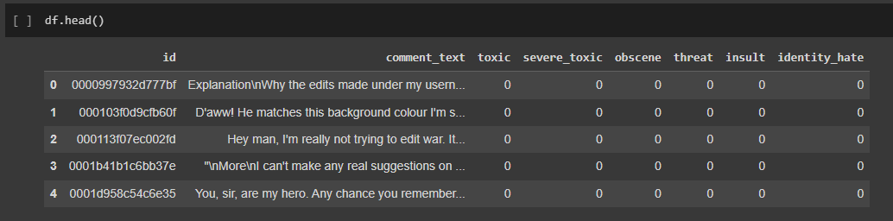
Input comments
Corresponding labels

Slide 9
Pre-processing - Tokenization
______________
____________
_____________
________
____________
[46, 2, 97, 114, 33, …]
.
.
.
convert to
sequences of integers
Inputs
Tokens
Notes:
Tokenization is a pre-processing step in which we take our inputs and convert them into tokens, sequences of integers.

Slide 10
Pre-processing - Embedding
[46 2 97 114 …]
Each word has certain attributes to represent
0.2 0.3 0.4 0.8 …
0.2 0.9 0.7 0.6 …
0.7 0.0 0.7 0.5 …
The attributes are then embedded with values to assist the deep learning model
Notes:
Embedding is a representation of a word that has certain attributes about it in which we represent it as integers or float values. These attributes and their values are determined by the deep learning model itself. The model will learn to recognize these attributes and set a number value to them.

Slide 11

Deep neural network
[0, 0, 0, 0, 0 ,0]
[1, 0, 0, 0, 1, 0]
.
.
[0, 1, 0, 0, 0, 0]
map out
the outputs
Output
layers
Input
layers
LSTM
layers

Slide 12
SET UP AND LOAD DATA
01

Slide 13

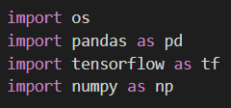
Install Dependencies
Installation required:
4 key dependencies needed to import:

Slide 14
02
PREPROCESSING COMMENTS

Slide 15
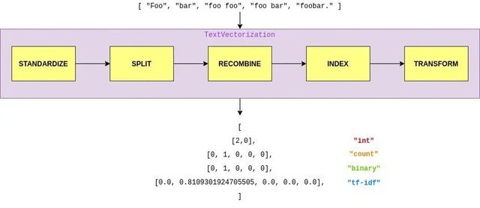
Import text vectorization layer
The text vectorization layer has basic options for managing text in a Keras model. The text vectorization can transform a batch of strings into either a list of token indices or a dense representation.

Slide 16
Split the data
We need to split our data into comments and features. Because we need our model to predict all of these fields (toxic, severe toxic, obscene, threat, insulting, identity hate) at the same time.

Slide 17
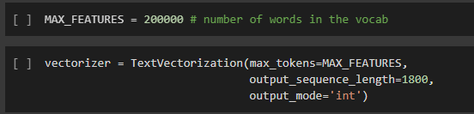
Initialize text vectorization layer
We going to initialize our text vectorization layer. In this part, we’re specifying how many words we want in the vocabulary, what is the maximum length of our sentences or the input length and the value of the outputs.

Slide 18
03
CREATING A DEEP NLP MODEL

Slide 19
Import dependencies
There are a lot of ways to build our model but the Sequential method is very simple and easy to use.
LSTM (Long short-term memory) is a special kind of recurrent neural network capable of handling long-term dependencies.
Embedding maps each value in the input array to a vector of a defined size.​ During training the network, it may learn what words are positive or negative.
Dense is a layer that is deeply connected with its preceding layer.
Bidirectional layer is going to be a modifier on top of that and it's going to allow us to pass the features or the values from our LSTM outputs.
Dropout layer only applies when training is set to True such that no values are dropped during inference.

Slide 20
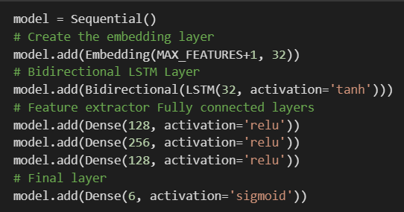
Instantiate the model
We're going to instantiate our model. This is going to instantiate the sequential API that we can add a number of layers to that particular model to be able to build it. To achieve this, our model requires these layers:
+ The embedding layer
+ Bidirectional LSTM Layer
+ Feature extractor Fully connected layers
+ Final layer

Slide 21
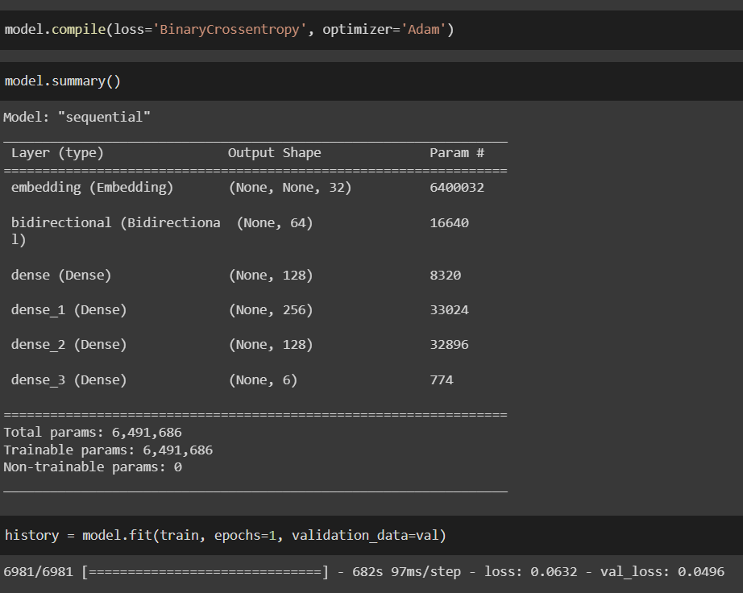
Compile and Train Model
In this part, we need to to compile the model. We choose the BinaryCrossentropy as our loss function. Because it can compute the cross-entropy loss between true labels and predicted labels. Also we use Adam for the optimizer. This method computes efficiently and has little memory requirement.
Then we train the model.

Slide 22
04
MAKE
PREDICTION

Slide 23
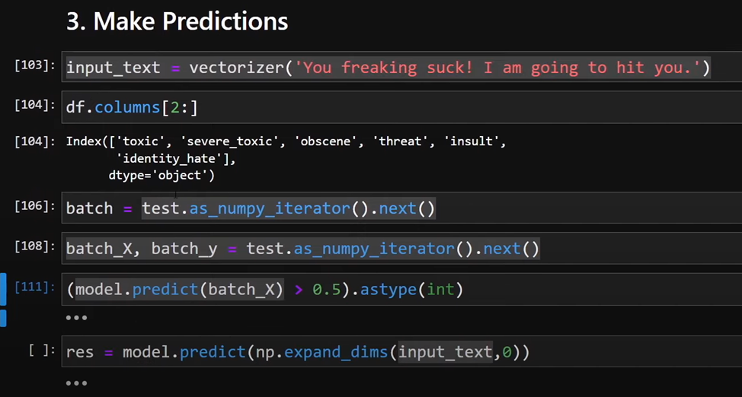
We first tokenize our text and use the model.predict method to make new predictions.
Get some text and run it through our vectorizer
Store our results inside of a variable called res and use model.predict method to make a predictions
Then we gonna classify the comments into 6 class with 6 distinct values
Compare that value with the dataset to evaluate and detect if it includes any of these characteristics: “toxic, severe toxic, obscene, threat, insult, identity hate”
Long story short, we can vectorize our text and then pass it through to model.predict to make a prediction

Slide 24
05
EVALUATING MODEL PERFORMANCE

Slide 25
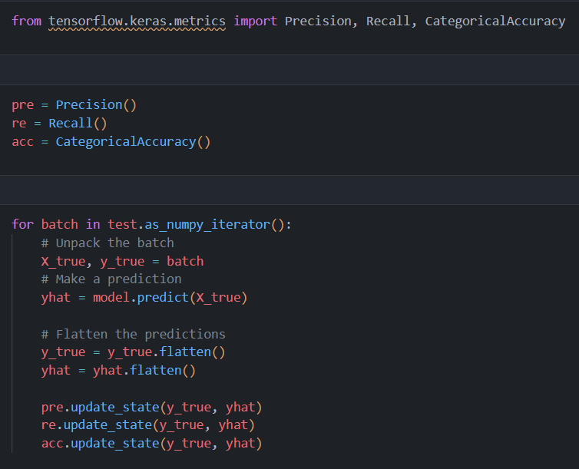
we can use metrics kind of like kpi to determine how well our model is performing
since we have multiple binary outputs we can use binary classification metrics like precision and recall
import metric
import precision, recall and categorical accuracy
it allows you to add results over time so you can get an aggregate metric over time.
we're going to loop through every single batch inside of our data pipeline
unpack a batch, making prediction, flatten the prediction,
update that 3 values and print it out.

Slide 26
THANKS FOR WATCHING!
Do you have any question?
I hope you don’t

Slide 27


